Slide 1
Rid Yourself of Reptiles!
Counteracting Plaintiffs’
Reptile Theory
Renee Eveland l Partner
Wolfe, Snowden, Hurd, Luers & Ahl, LLP l 1248 “O” Street
NDCA Annual Meeting, 2014

Slide 2
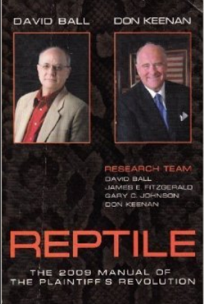
THE DEFINITION
“To show immediate danger of the kind of thing the Defendant did and how fair compensation can diminish that danger within the community.“
Source: Ball, David and David Keenan. Reptile, The 2009 Manual of The Plaintiff's Revolution, p.30 (Balloon Press, 2009) (emphasis supplied).

Slide 3
Theme of reptile theory
In short, the advice is to talk about everything except the facts of the case.
Med Mal Example - Chapter 21 “Bad Med Facts.”
[Shocking] Quote: “Bad med points are not standard-of-care violations but they are every bit as important.” [FN]
Play on people hating waiting rooms; doctors talking down to patients; doctors being dismissive; doctors not being respectful of time.
Other cases: Hypocrisy or lies of any fashion, whether causally related to the claimed injury or not.
[FN] Ball, supra, Ch. 21, p.248 (emphasis supplied).

Slide 4
THREE defensive techniques

Slide 5
“REPTILIAN-REVULSION” TECHNIQUE NO. 1: Defensive Bias

Slide 6
TECHNIQUE NO. 1: Defensive Bias
The instinctual belief that harm can be avoided. People psychologically resist accepting that bad things happen that a plaintiff could not have avoided.
Defensive bias is an inherent psychological edge.
Ball et al. acknowledge jurors tend to blame Plaintiffs (even when contributory negligence is not pled). [FN]
Example: I would have been more proactive than that patient.
Example: I would have taken evasive action that would have prevented the accident from happening.
Evaluate the strength of case and themes from an understanding of this and utilize it.
[FN:] Ball, David and David Keenan. Reptile, The 2009 Manual of The Plaintiff's Revolution, p.30 (Balloon Press, 2009).

Slide 7
“LIZARD-SLAYING” TECHNIQUE NO. 2:
Nebraska Law on Punitive Damages

Slide 8
TECHNIQUE NO. 2: NEBRASKA LAW ON PUNITIVE DAMAGES
Well-founded, motion in limine in all cases to curb the following Reptile advice:
Reptile Quote: "…[A]rgue public policy underlying compensation and negligence laws…." Ball, supra, p.39 (emphasis supplied).
Reptile Quote: "Even without a punitives issue [in the case], you are usually within bounds in pointing out the effects of proper compensation if you do not use those effects as a measure of what the compensation should be." Closing argument example: "A jury represents the community. The jury's job is to apply the law to the facts – on behalf of the community. …[C]onsider…the effect your decision has on the community." Id. at p.44.

Slide 9
“HOW TO MAKE A HANDBAG” TECHNIQUE NO. 3: M.I.L.s

Slide 10
TECHNIQUE NO. 3: MOTIONS IN LIMINE
Listen during depositions. Respond with case-specific, pointed motions in limine to themes that broaden the case beyond the facts of the case or that would have no causal bearing on the claimed injury.
Look for safety rules and safety themes (e.g., ask about it in written discovery, depositions). In a case where the standard of care governs, this is objectionable as mis-defining the SOC. In a case where statute governs the definition, it too, may erroneously define or contradict a jury instruction.
Watch for generic hypotheticals raising claims of damages or harms that did not, in fact, occur. Pre-educate the judge on the possibility based on what you have heard. (If a doctor does not follow DD, people can die.) Pre-address in depo-prep.
Listen at trial. Cut off the themes and hypotheticals, when your (likely overruled) motion in limine comes to
fruition.

Slide 11
Sample moTION IN LIMINE med.mal. case
IN THE DISTRICT COURT OF ______ COUNTY, NEBRASKA
Plaintiff
v. Defendant’s Motion in Limine
Dr. Defendant
COMES NOW Defendant and seeks to exclude…
Any references to "rules" or "safety rules" that healthcare providers must or should follow when treating patients. This phraseology is a misrepresentation of the standard of care on which the jury will be instructed under NJI 12.01 / NEB. REV. STAT. § 44-2810.

Slide 12
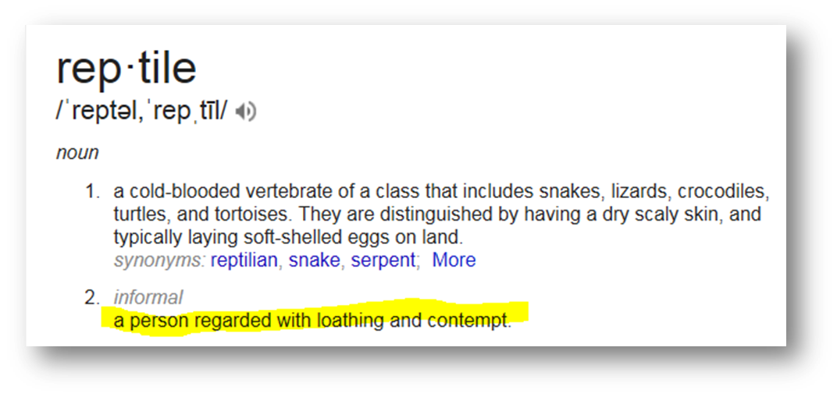
A NEW DEFINITION….?

